Slide 1
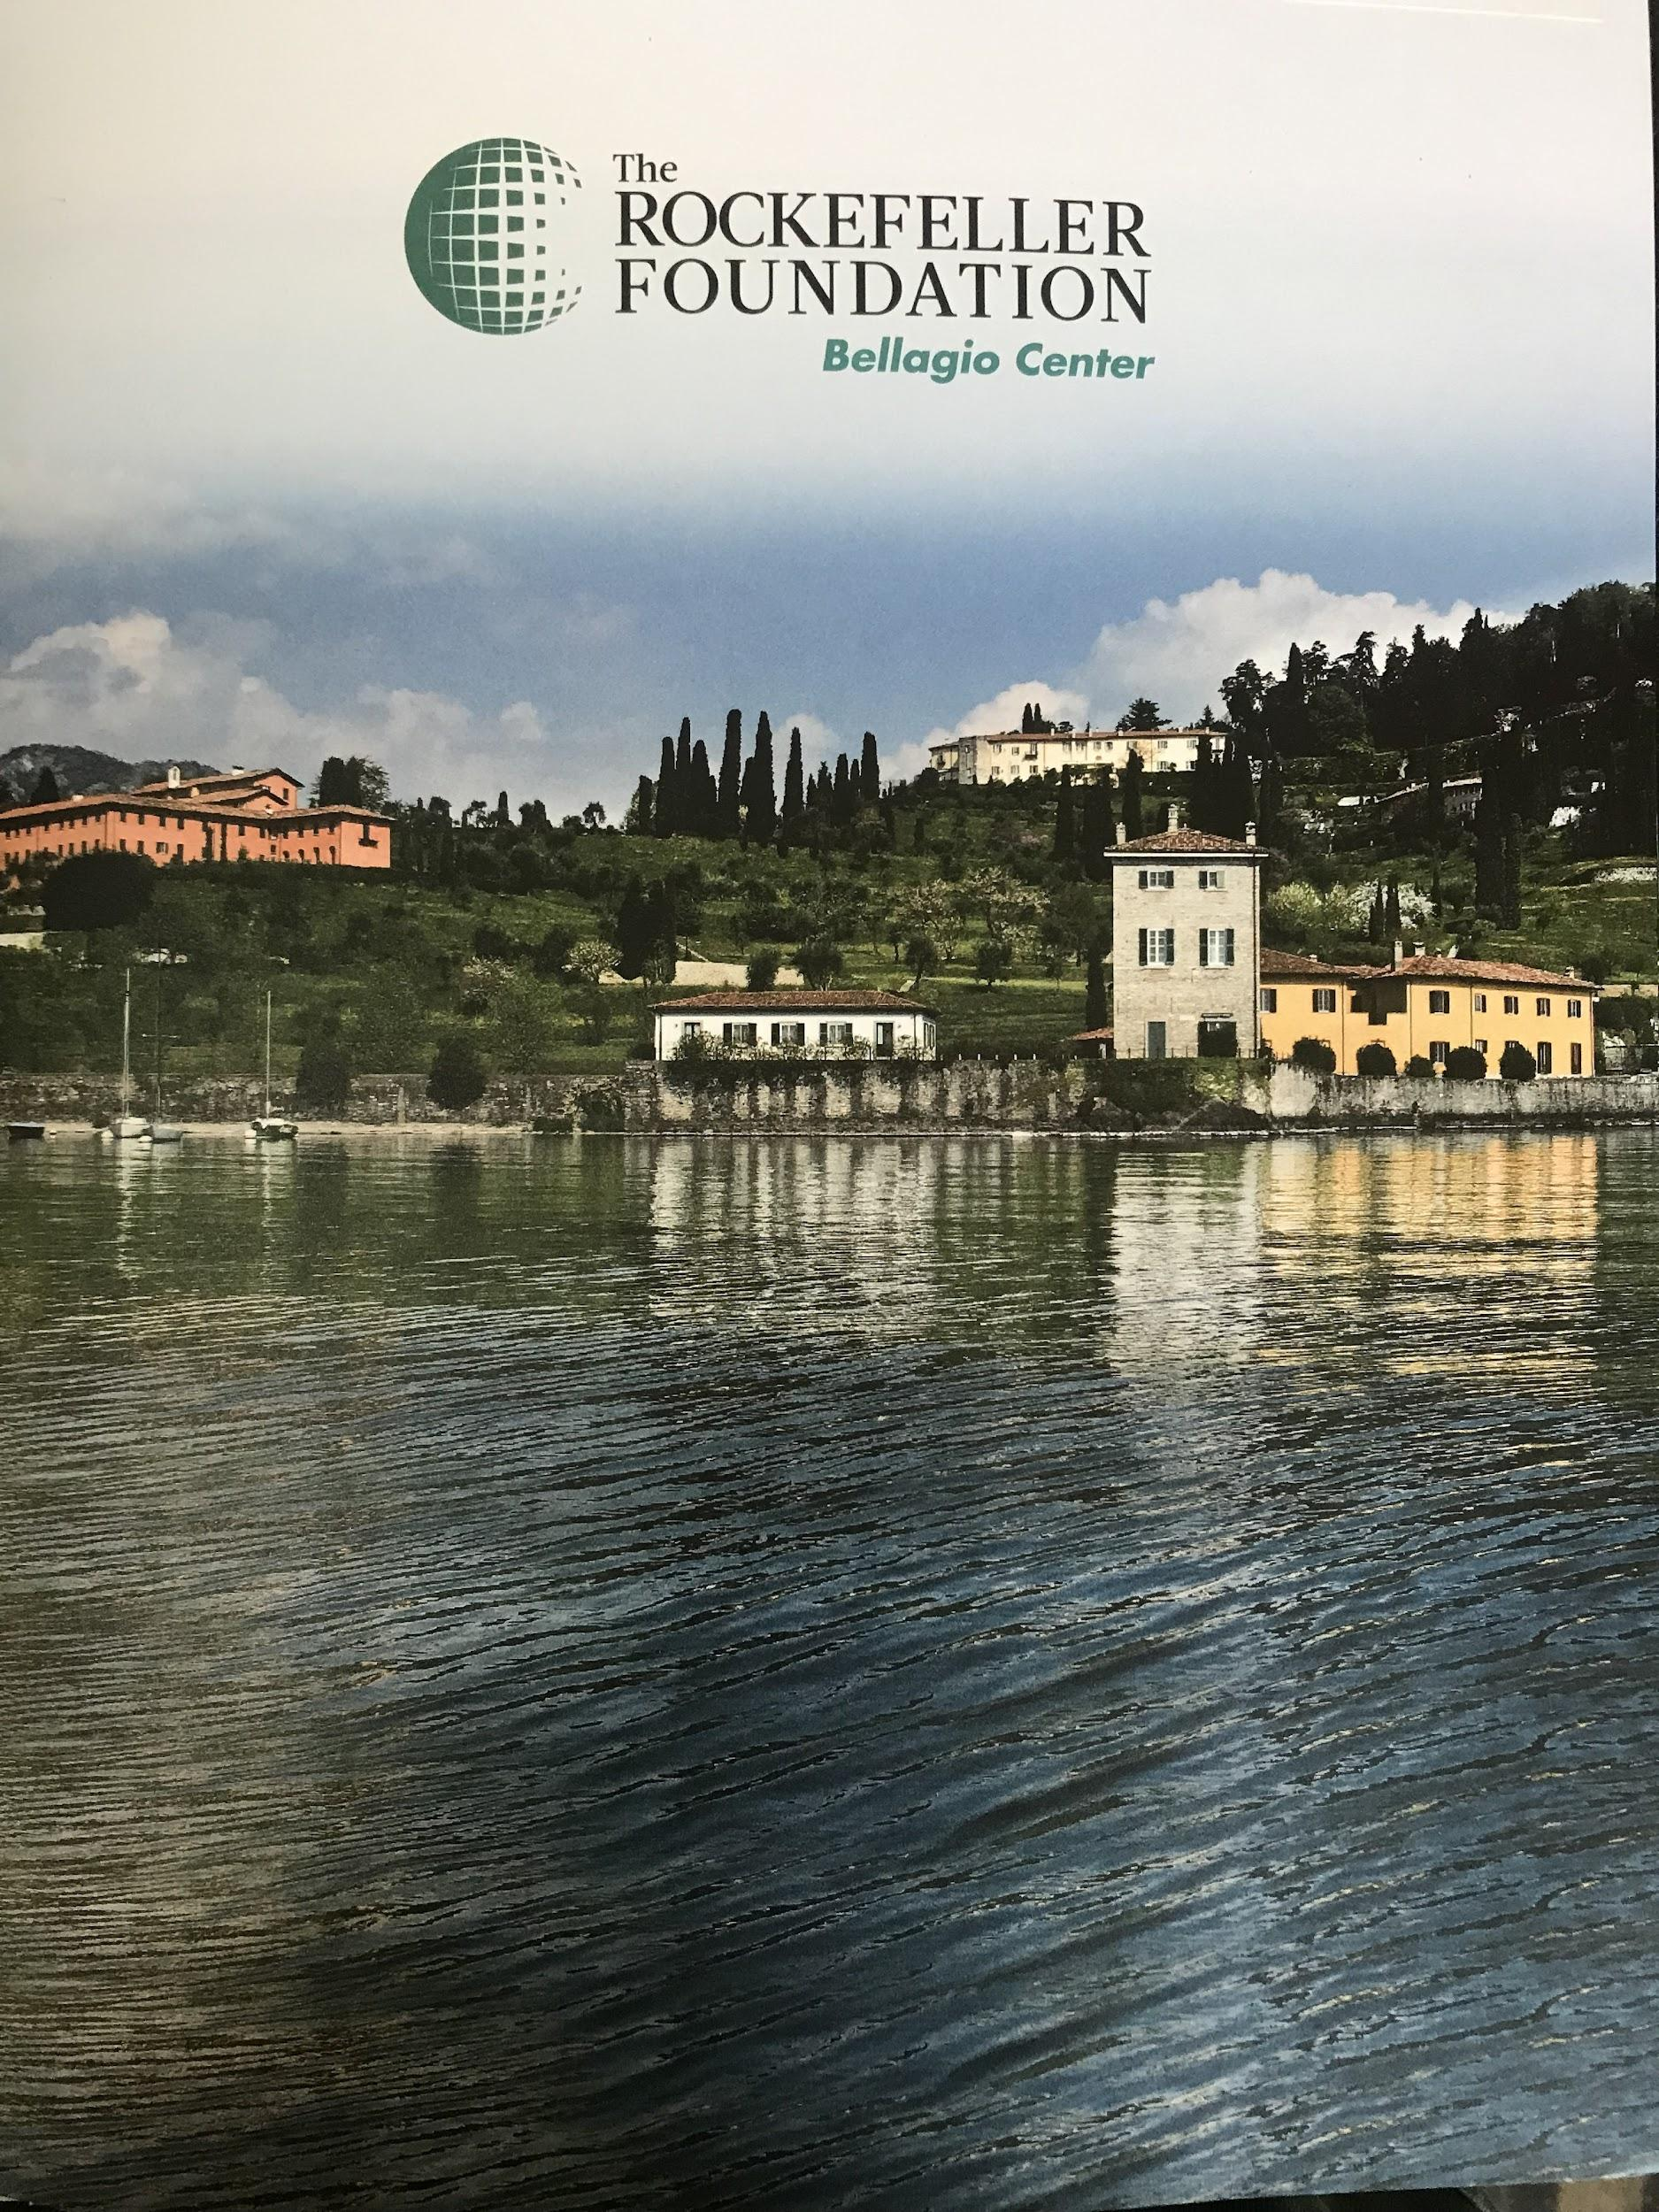
Reparations and Racial Healing in Africa and Beyond
Reparative Justice For Historical Crimes
at The Bellagio Center
July 12–16, 2022

Slide 2
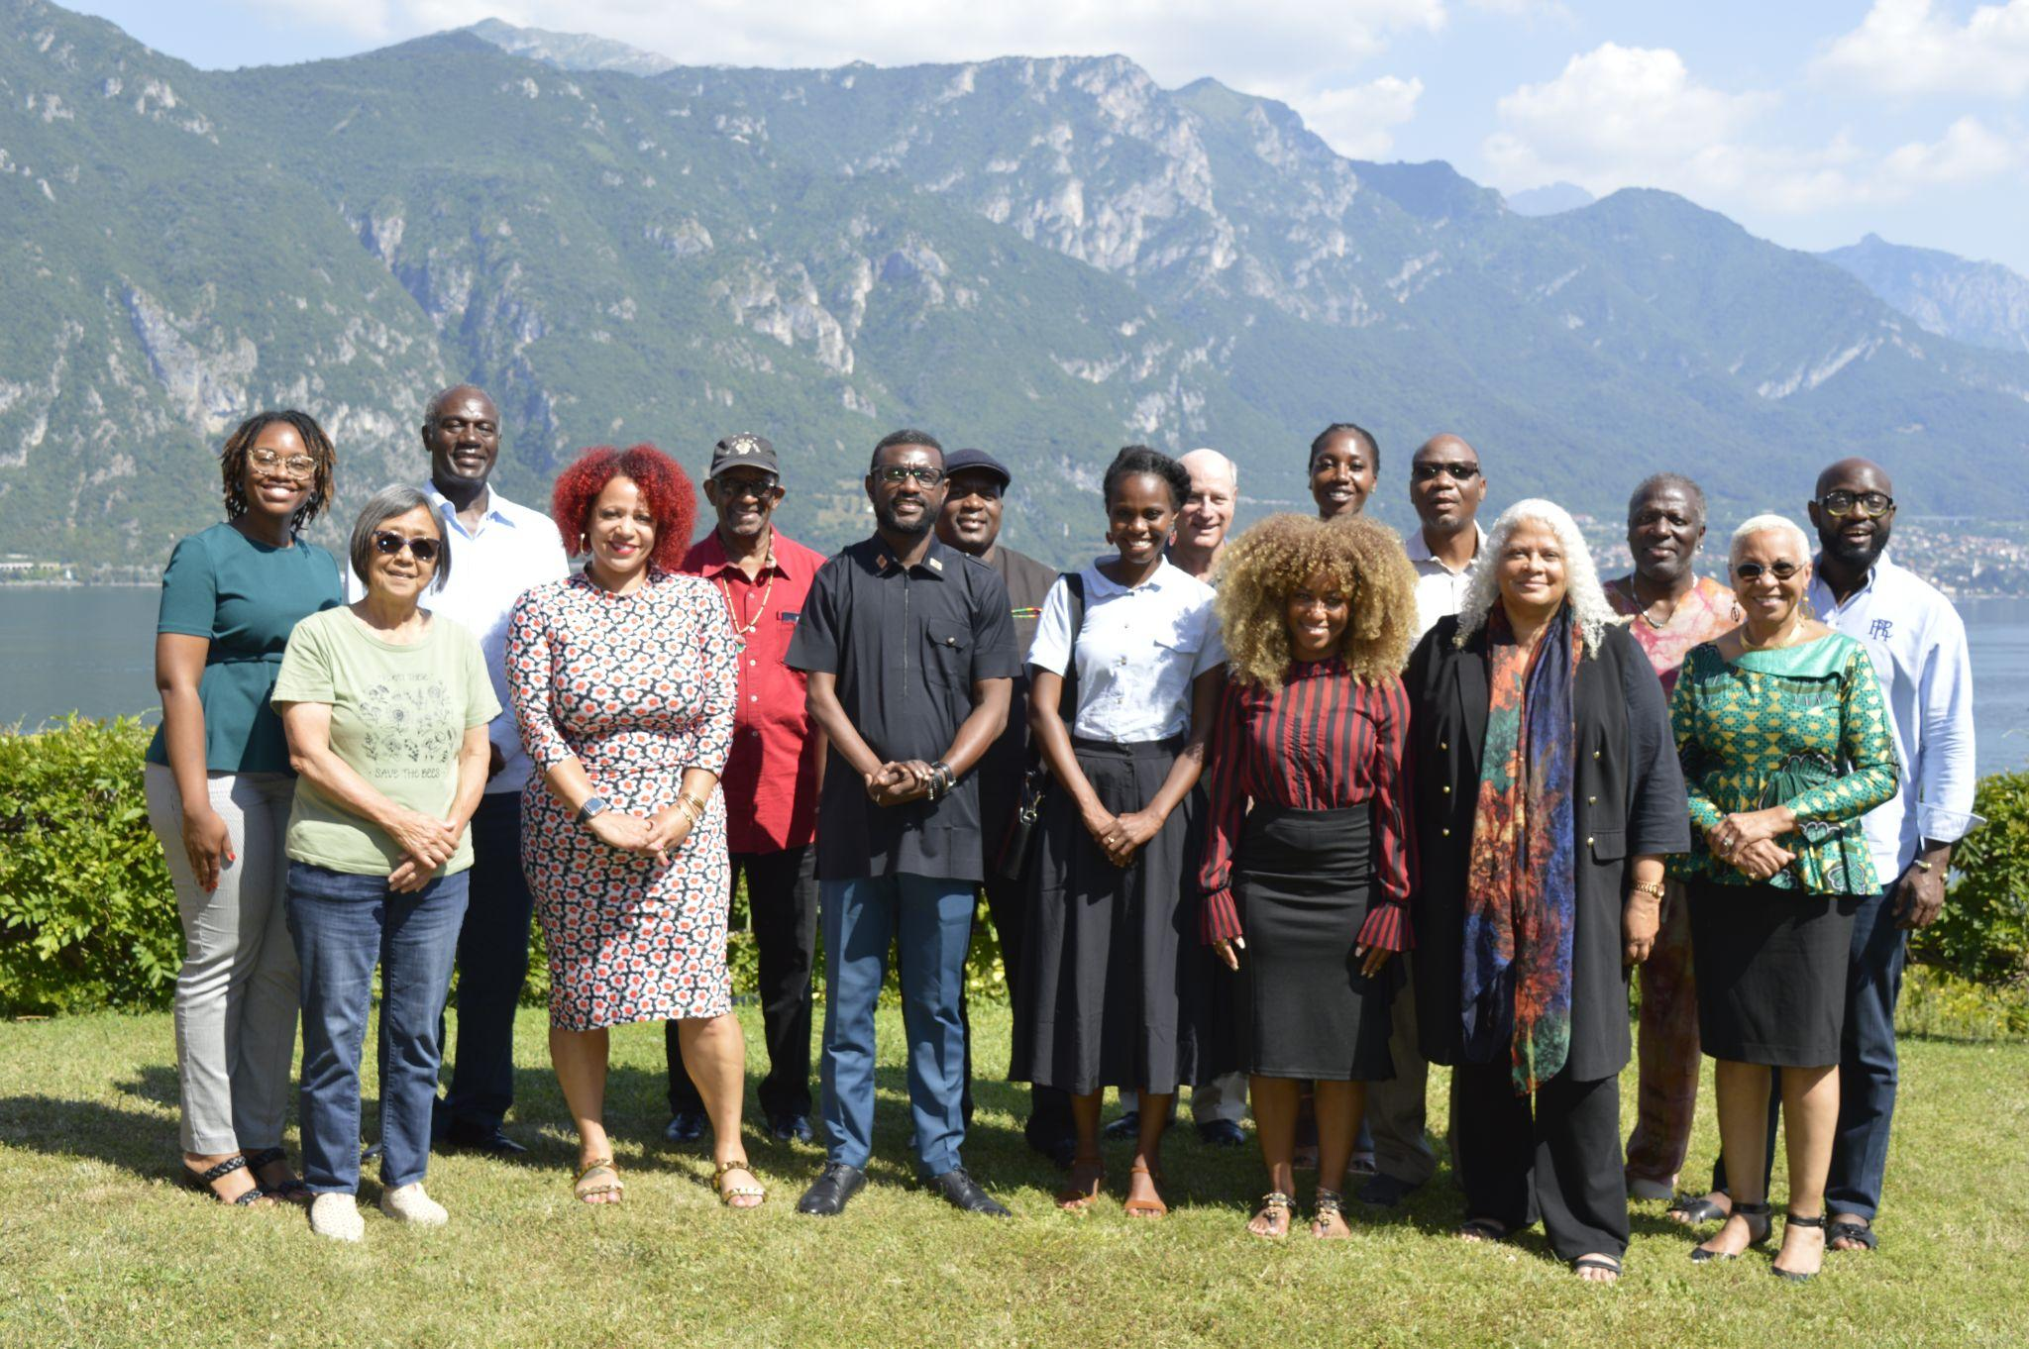
Who was at the Convening
Photos by Allen Mays, Videographer/Photographer from Howard University
Attendees on Zoom: Phyllis Hill, Kimberly Collins, Enola Aird,Yvonne D-Poku, John Ikubaje.

Slide 3
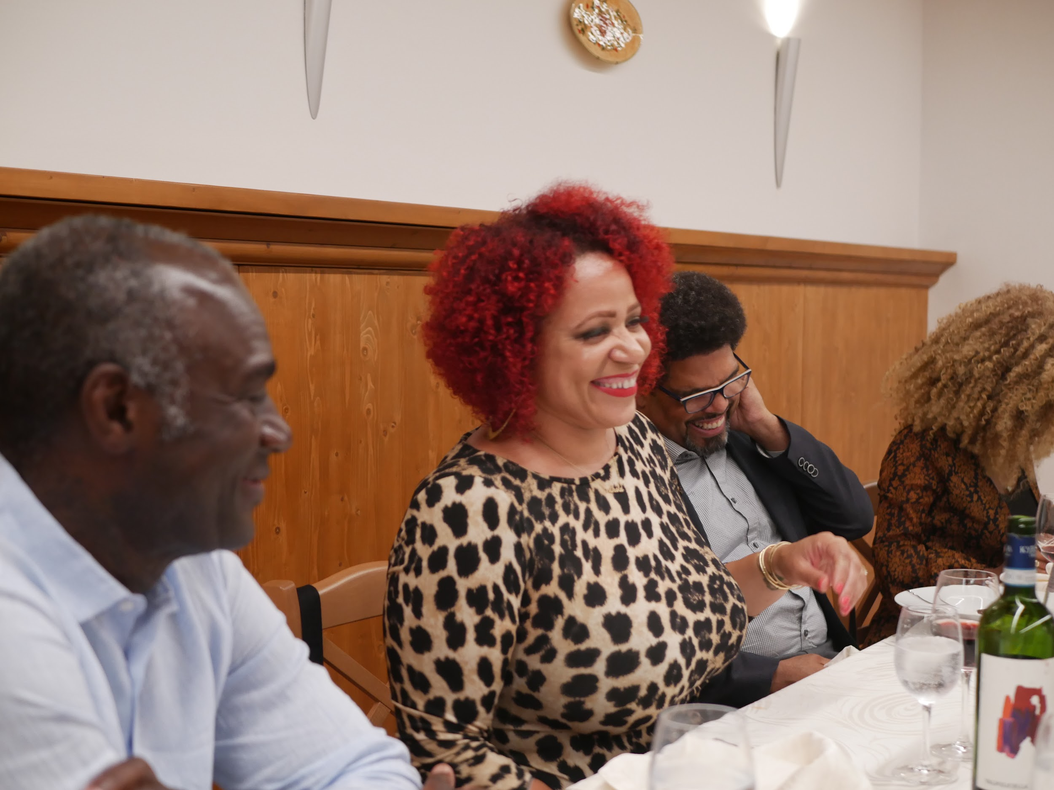
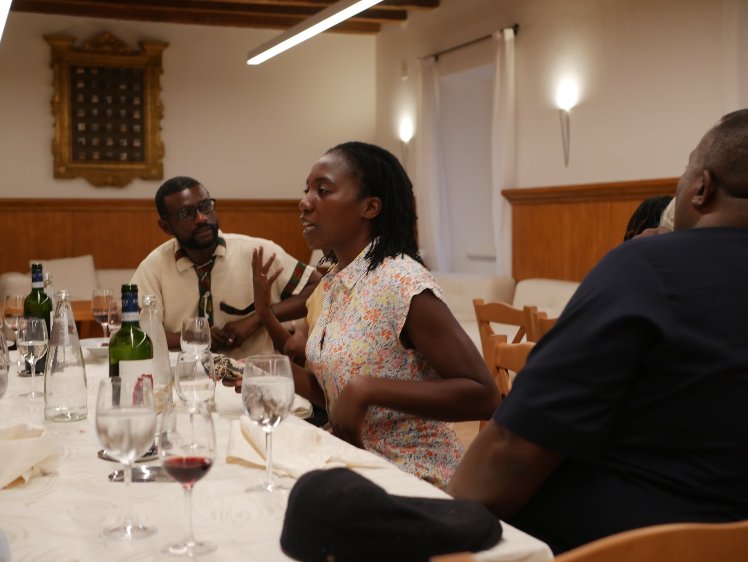
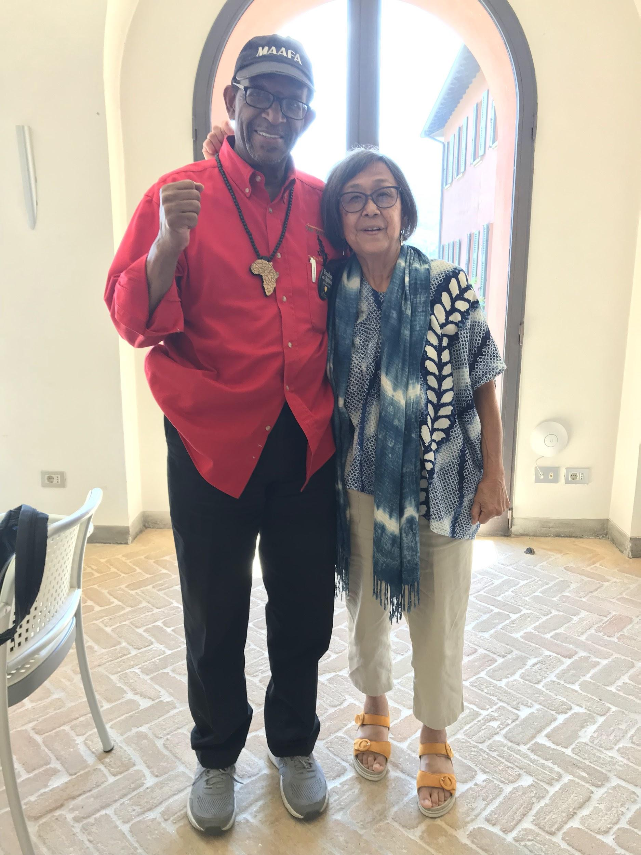
Goals/Approach/Hoped for Outcomes
A gathering for reparations and healing experts from around the world to build relationships and learn from each other in order to deepen their understanding of, and develop and refine strategies to advance reparations and healing work in their own spheres and as a collective.
All Voices even over Expert Voices/Relationship-driven even over
Content-driven/Surfacing even over Deciding
Draft of a shared declaration or collective action/Summary notes to share with Accra planners and attendees*
Convener:Nikole Hannah-Jones
Facilitators:Amara Enyia/ Dr. Ron Daniels

Slide 4
What Happened Each Day:
Icebreakers: What are you reading now? Favorite food?
Small groups:Challenges and takeaways/deepening the discussion
Presentations:
Reparations framework: 5 key elements (restitution, compensation, satisfaction, cessation and non-repetition, rehabilitation)
Healing Work and Legacy of the Transatlantic Slave Trade
Global systems (aid policy,international monetary systems, global institutions ie. International Monetary Fund and World Bank and how they continue to exploit Africa and the African diaspora
Precedents for Reparations - Evanston, JA redress/reparations (film about Namibia)
Reparations Advocacy - HR 40, role electoral politics

Slide 5
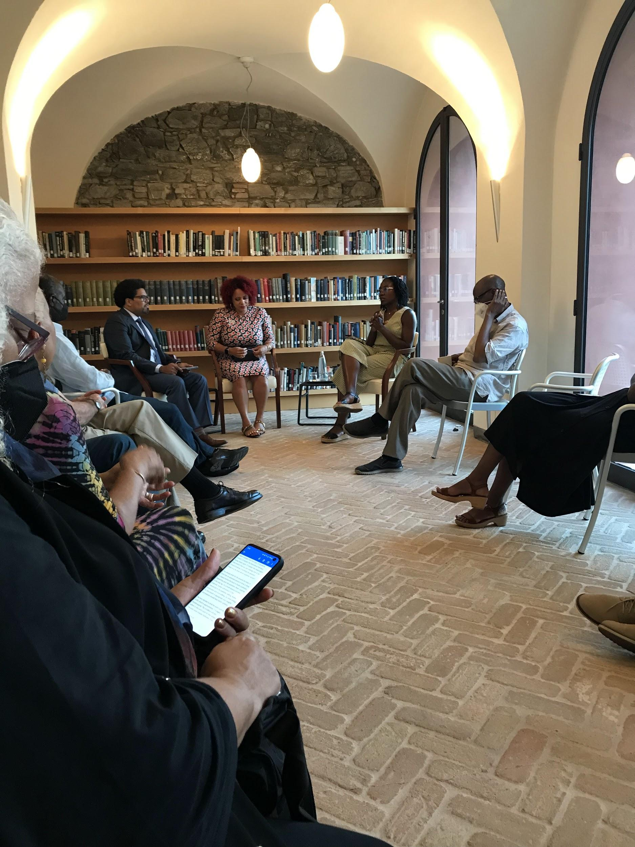
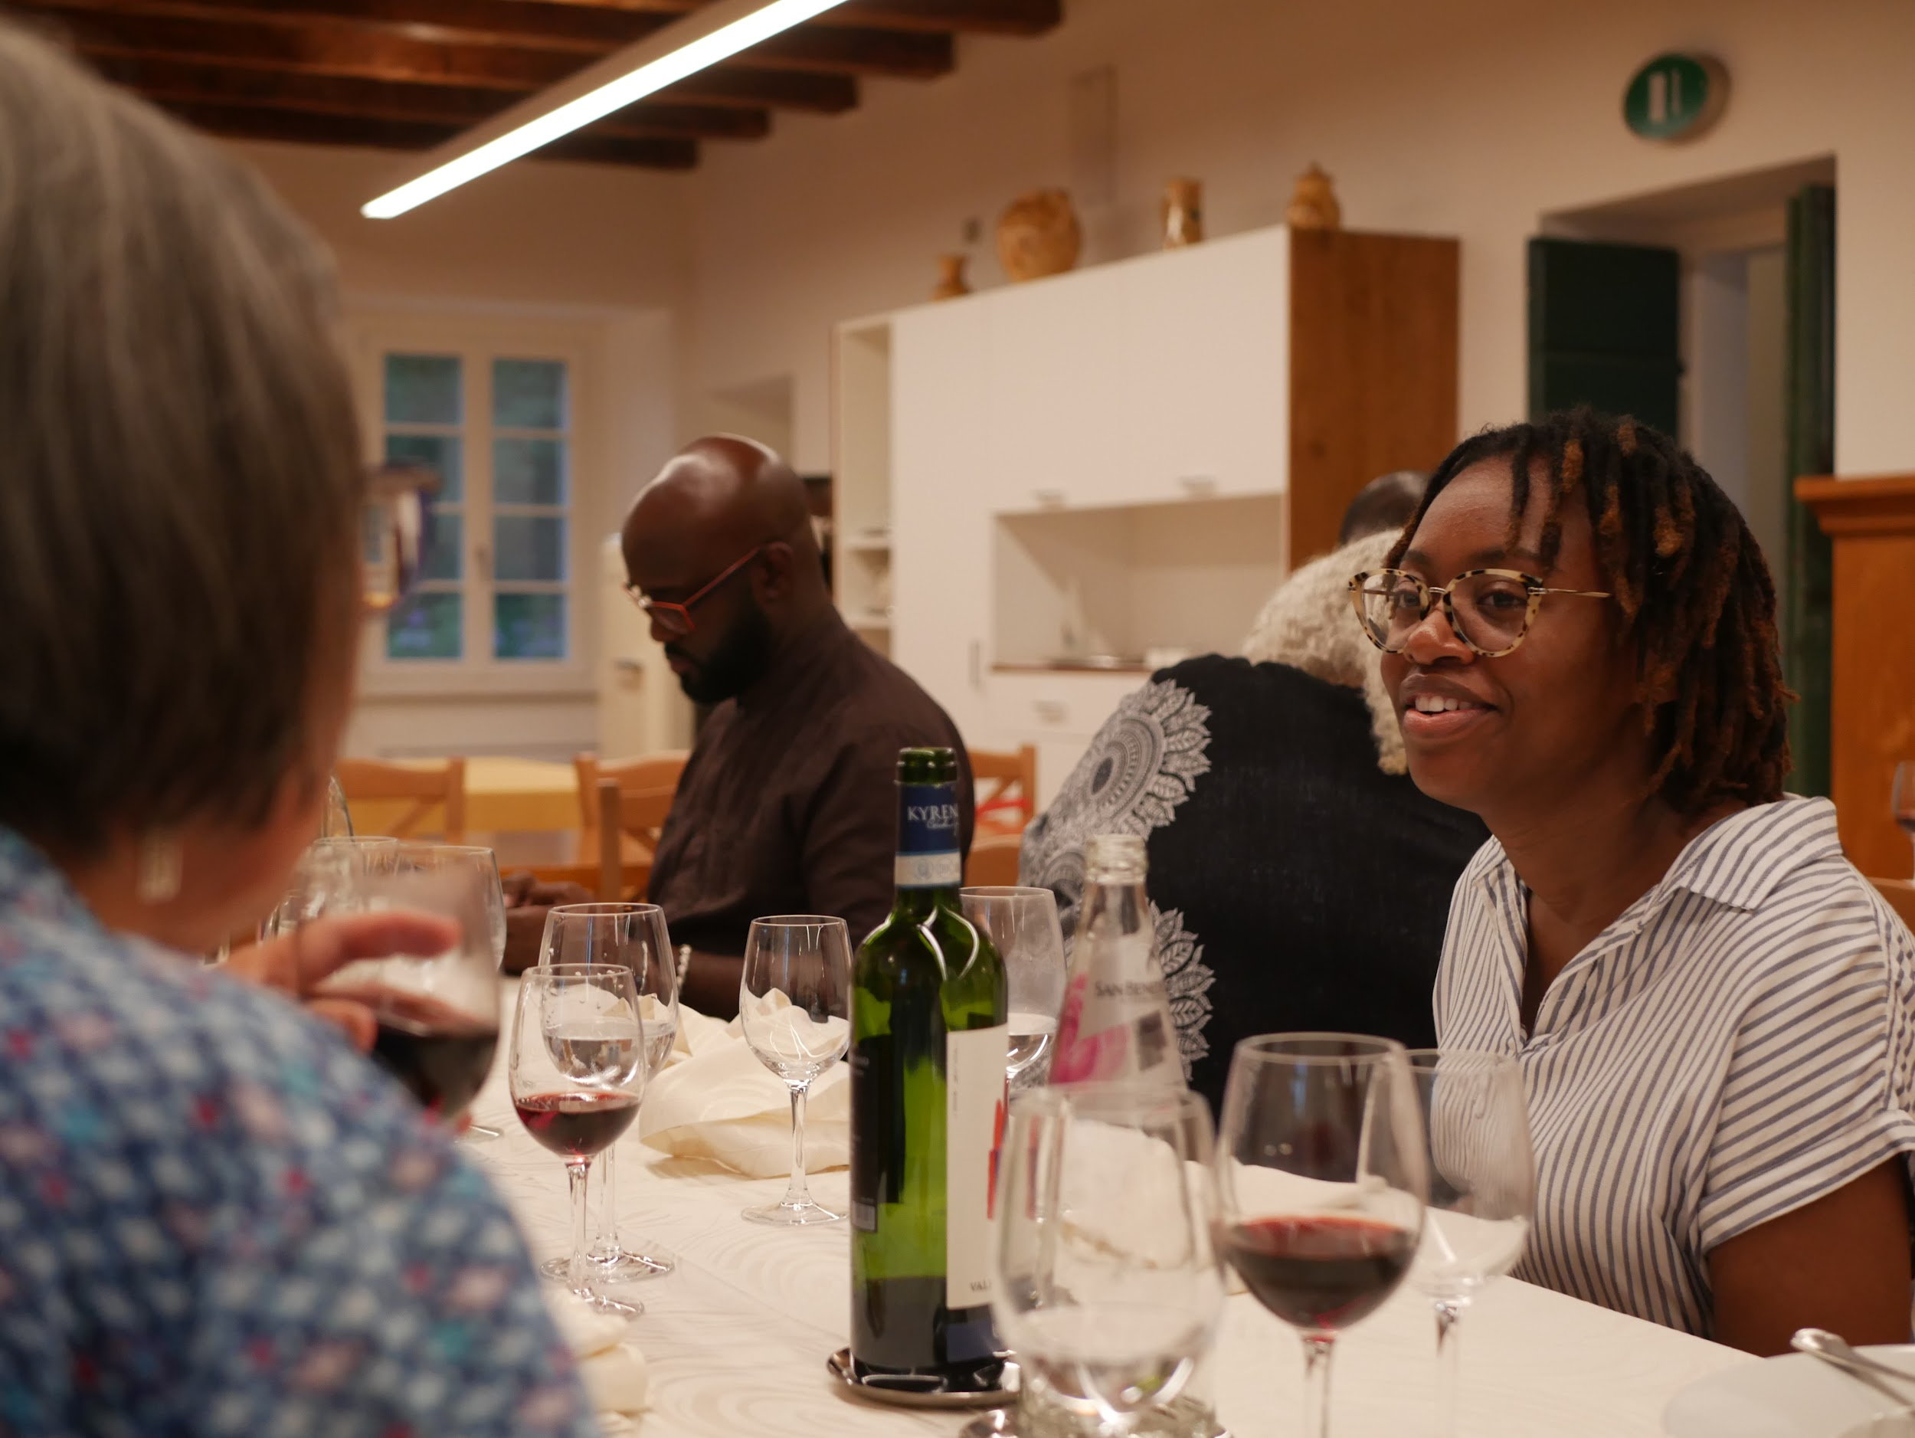
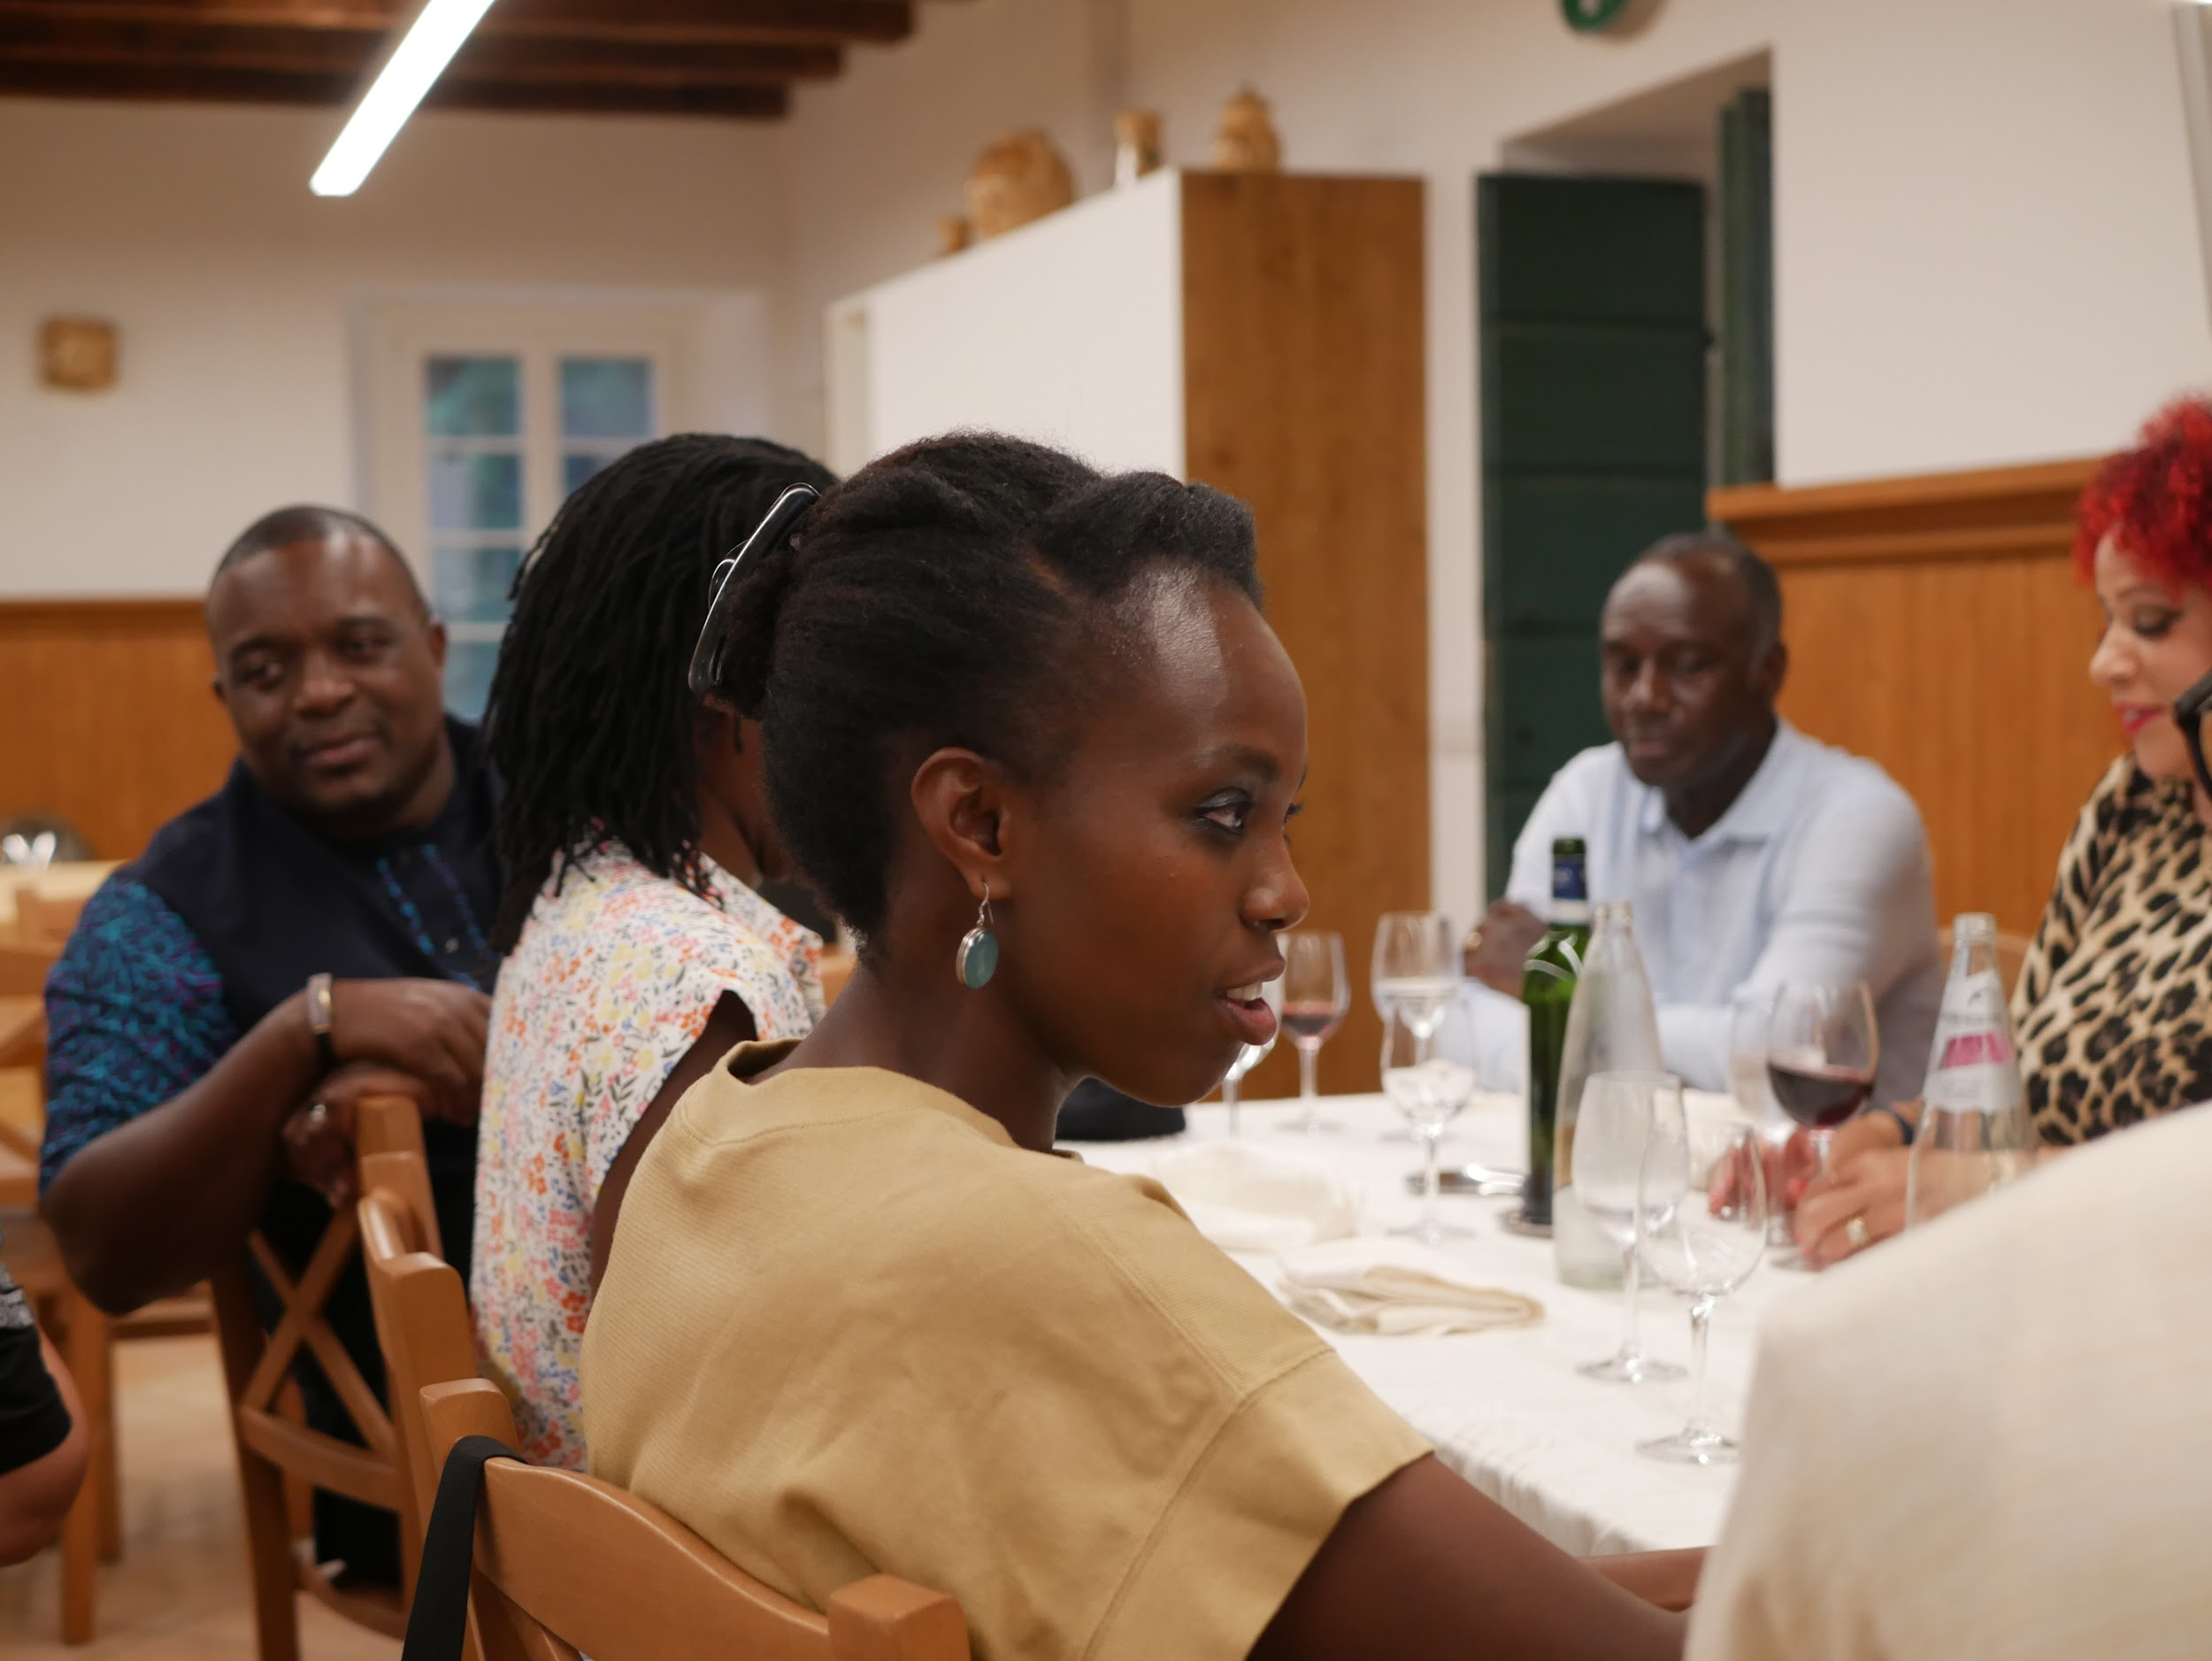
Informal gatherings and talks
Fireside Chat with Nikole Hannah-Jones/ Derrick Hamilton, Prof at New School
And conversations over dinner and wine!
Deanne Hayden, Doctoral Student at Howard and Liliane Umubyeyi, Co-founder and Co-Director of African Futures Lab (Rwandan from Belgium/Paris)

Slide 6
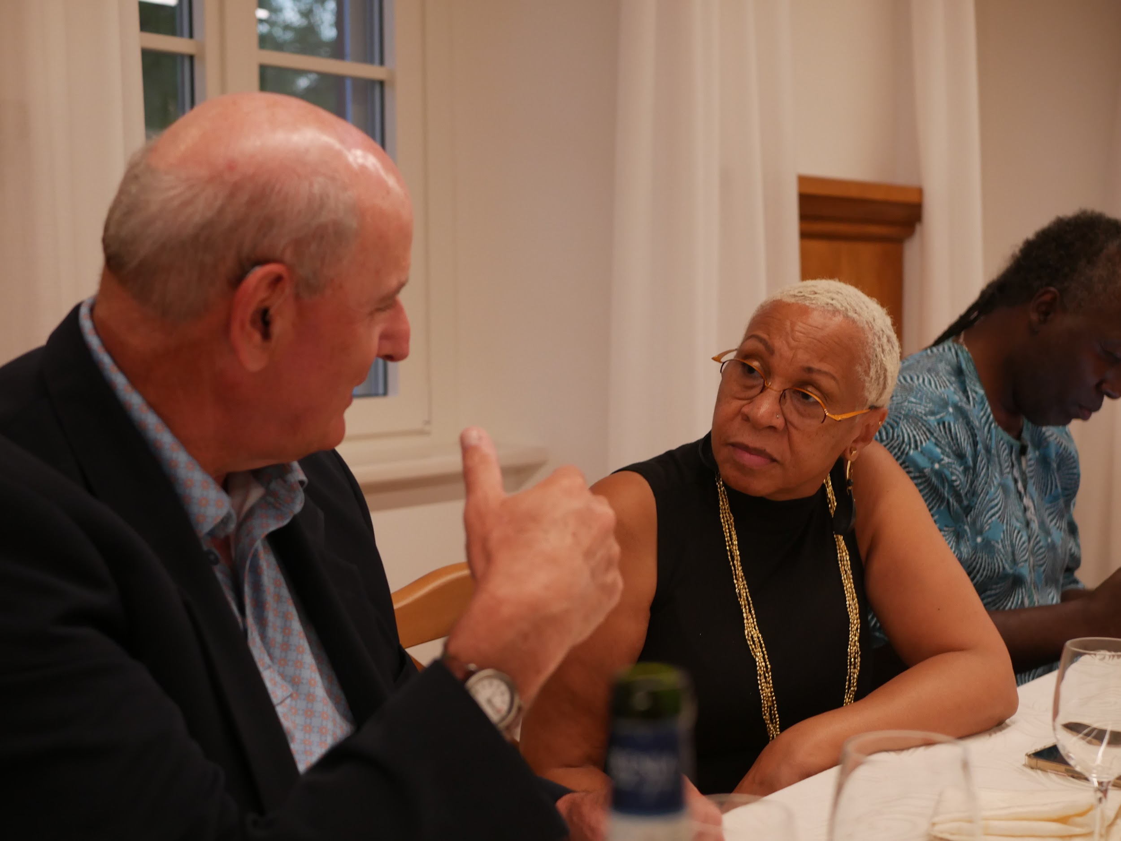
Healing Trauma
Dr. Joy DeGruy on Heal and Restore in Community
PTSS:Post traumatic slave syndrome
Enola Aird (via Zoom) on Community Healing Network

Slide 7
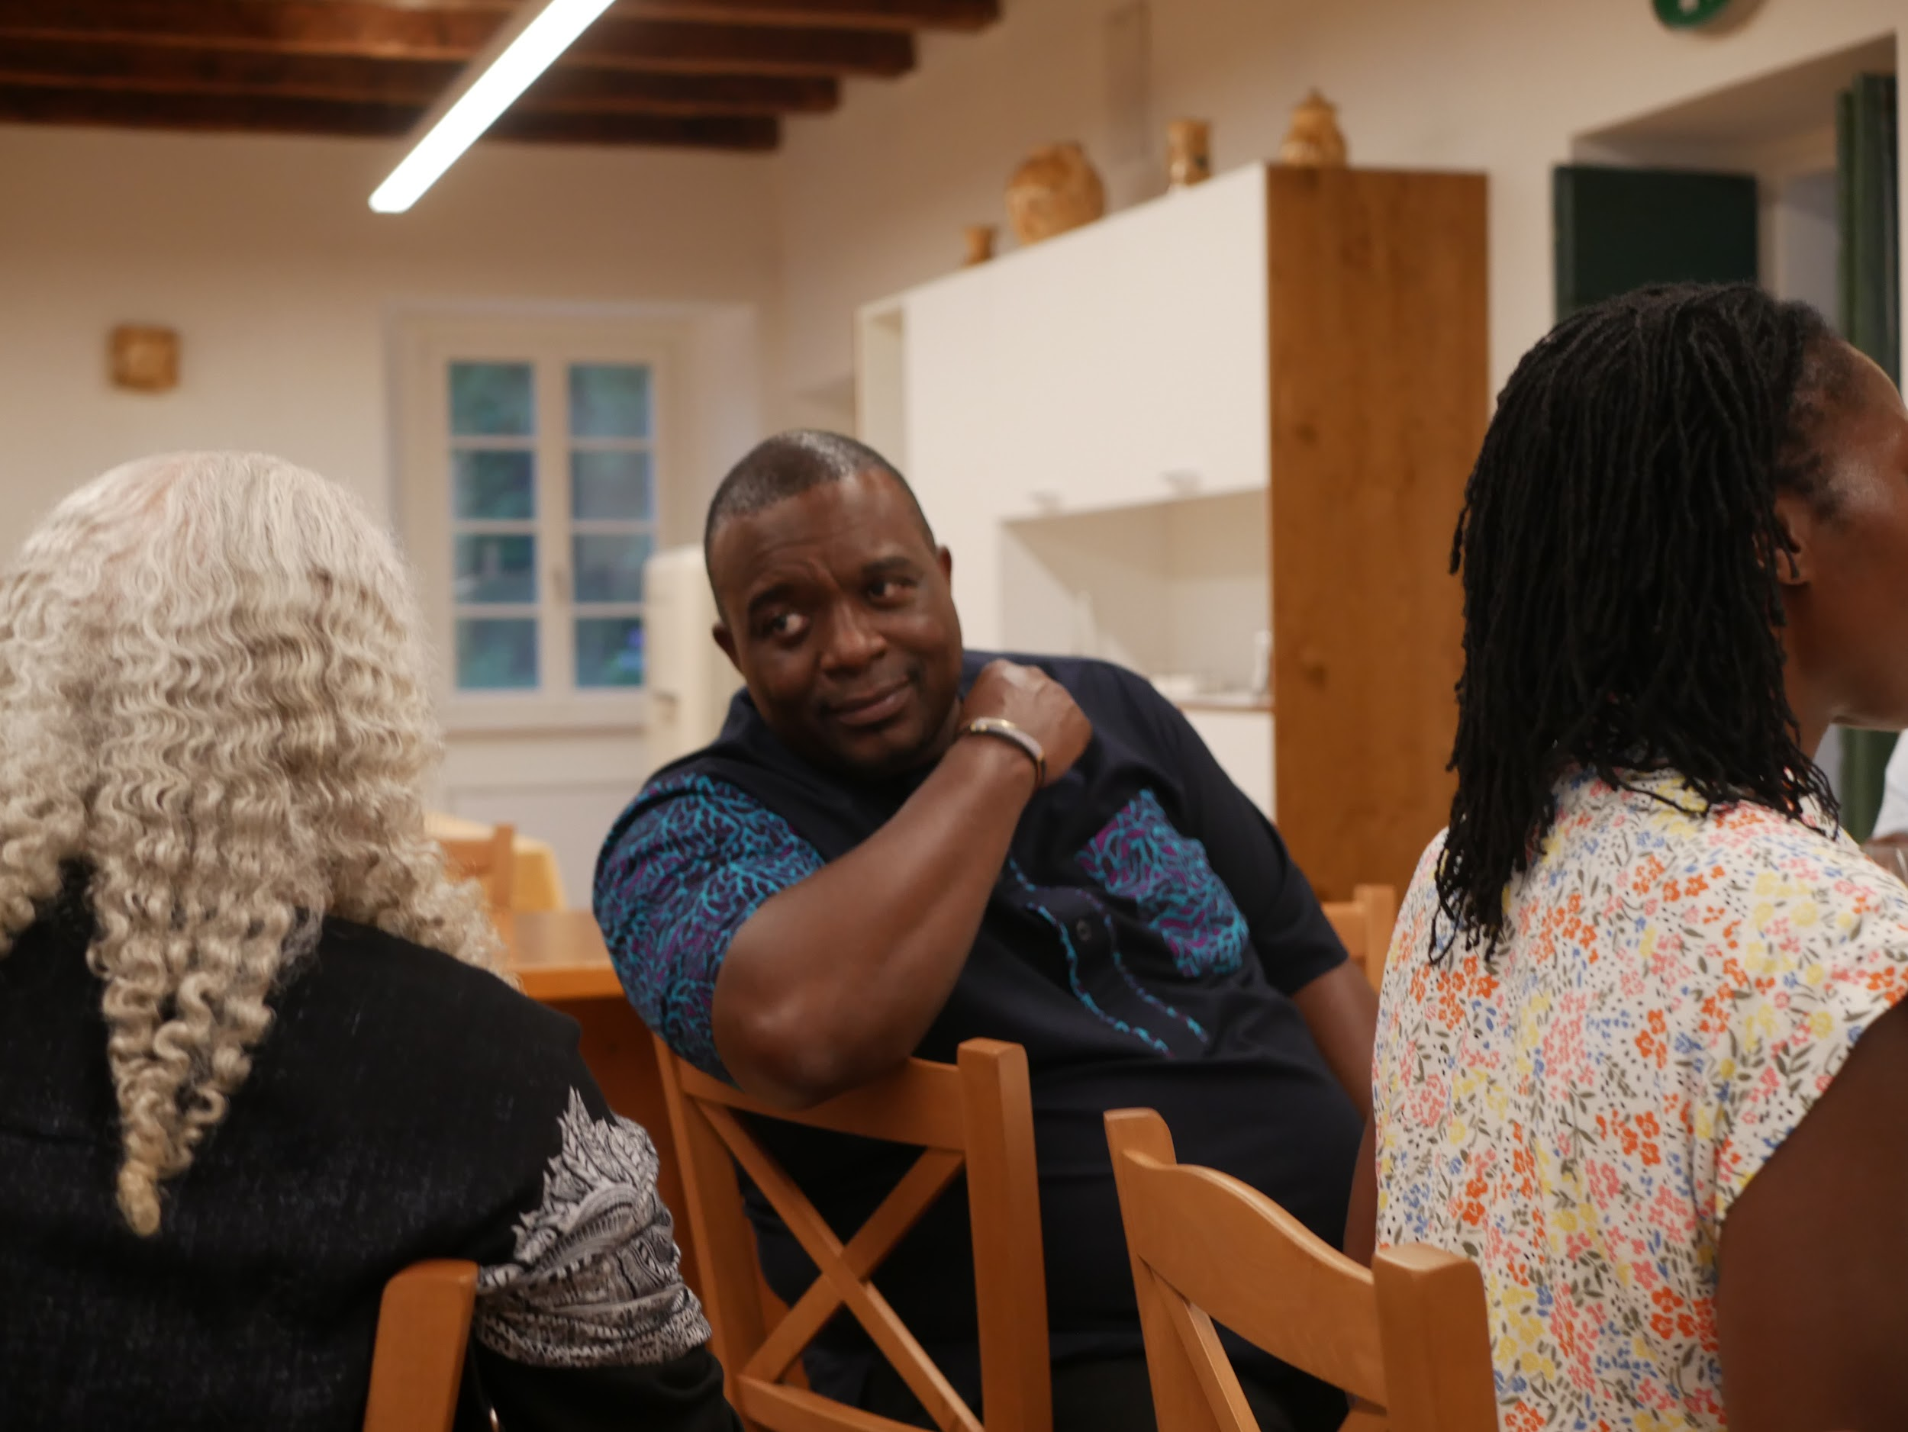
African Politics, Trauma
“Bring our ancestors and humor into the room”
“We are not perfect but we are enough”
Brian shared a lot of history of African politics and talked about how global economic systems and institutions control the economy of Africa. Here are some titles from his reading list:
Video – Conversation with Brian Kagoro
Namibia: The Price of Genocide
Brian Kagoro: Global Director, Justice & Intersectionality/Open Society Foundations
Zimbabwe, Africa

Slide 8
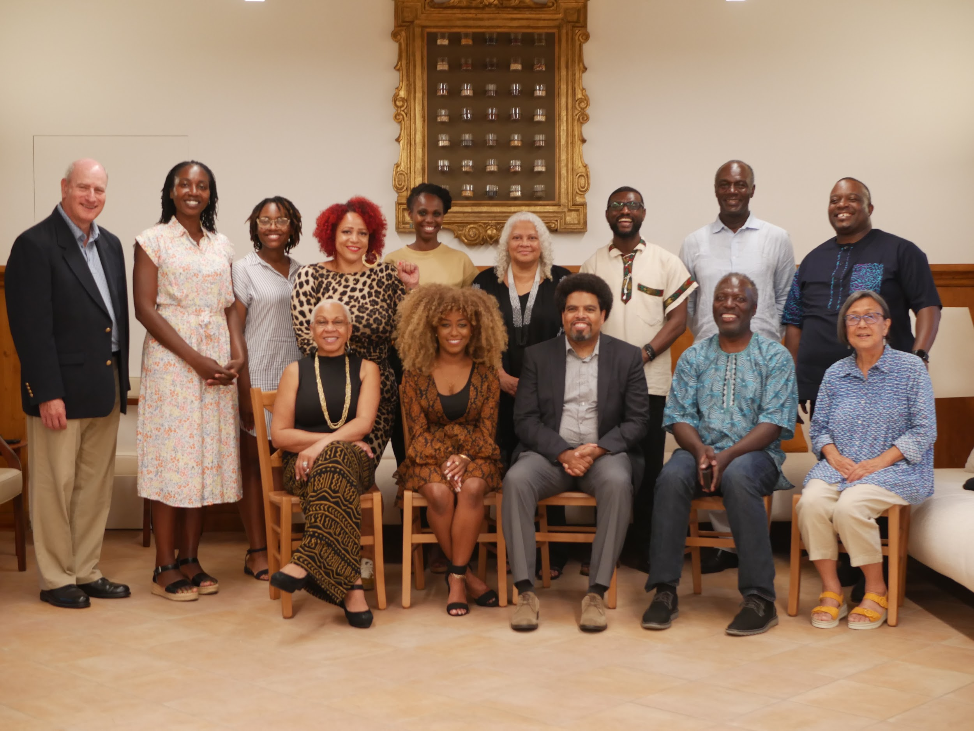
Reparations Past and Present: JA Redress/Evanston
Key Talking Points (working document which includes: history of the incarceration/personal connection, long history of racism, role of Blacks in leading the fight, Third World solidarity, working with all sectors etc.)
Support for Black reparations, formation of the NNRC, Principles of Unity and importance of learning/how our study of reparations today is informing our understanding of JA reparations.

Slide 9
Comments on JA Reparations
Terminology- “first generation” (related to camp experience or immigration)?
Never heard about JA incarceration - from an African person
How did we win over people beyond the core supporters
Liked the POU of “centering the leadership of Black led orgs”
Appreciated hearing the in-depth and detailed sharing of JA reparations movement
Reflections by a younger (non-JA) person who studied Japanese American redress:
1) Well-organized and unified injured community (lead with directly impacted voices to humanize and concretize the issues, allies in the Black, White and AAPI communities that show up, bridged ideological and generational divides)
2) Mobilizing narratives: word choices such as redress and reparations, focusing on wartime violations and constitutional rights versus accountability for racial terrorism
3) Living memory: time gap between the harm and movement was short/perpetrators are clearly identified and able to show generational chain of harm
4) Five keys to set up success for the movement for Black reparations include the above as well as a media strategy to saturate and be in every space, political will and minimizing infighting, allies showing up and defining our humanity (anti-Blackness is a unique stumbling block for Black people).

Slide 10
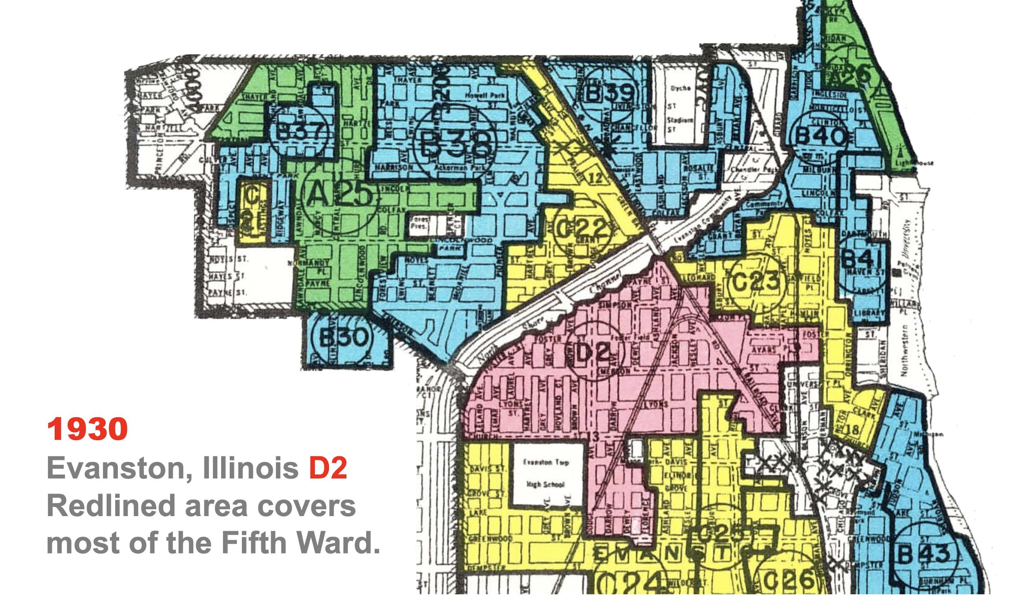
Government-Sanctioned Redlining Segregated the City of Evanston, Illinois

Slide 11
Evanston Reparations
City and community funds:
City of Evanston Reparations Fund and the Reparations Subcommittee
Evanston Reparations Community Fund - accepts individual donations
Governance is through the Reparations Stakeholders Authority of Evanston and a board of over 20 people from all aspects of the Black community
Strong involvement and support from religious community:
The Interfaith Clergy & Leaders of Evanston announced a coalition to educate their membership, raise money for the Fund, and to begin a process of reconciliation and repair
Individual churches have donated funds to the Community Fund, repaired streets and taken steps to educate
Evanston is the first governmental body in the United States to pay reparations to Black Americans since Reconstruction
Reparations by a municipality are constrained in several ways
Methods used were selected to prevail against litigation
With no preexisting models, continuous process of reevaluation while moving forward
Payments to individuals versus structural reparations
Black community engaged
Far lower engagement by “White” community

Slide 12
Bellagio Convening - 15 Takeaways
1. Commitment to consolidate – bring our efforts together to align where possible to increase effectiveness and reduce redundancies
2. Create a narrative of survival and development
3. Clearly identify complicit parties (perpetrators)
4. Commit to a process of healing the wounded
5. Commit to dismantle anti-Black systems and processes
6. Develop strategies and plans that create reparative systems, structures, and organizations
7. Strengthen and build the capacity of organizations and formations leading reparations efforts
8. Identify and assemble scholars and experts that can support with research, analysis, and strategy development
https://mail.google.com/mail/u/0?ui=2&ik=8e179315a&attid=0.1&permmsgid=msg-f:1739002338576888406&th=18222d69ce72f256&view=att&disp=inline&realattid=f_l5uxnldx0

Slide 13
Bellagio Convening - 15 Takeaways Con’t
9. Identify Heads of State with whom we can build our work at the international level
10. Develop strategies to enlist non-African allies
11. Engage faith institutions of all types to join in this work
12. Enlist foundations and other private and public philanthropy to engage in this work
13. Develop strategies for intergenerational engagement, particularly with a focus on engaging young people, increasing opportunities for intergenerational learning, dialogue, and collective action
14. Develop a clear strategy for engaging media. Understanding the role of building a narrative around our collective work (particularly global work), sharpen the ways in which we engage the various forms of media (television, radio, print, digital, etc) in ways that advance our cause
15. Determine the role of consensus-building especially considering the diversity of reparations advocacy groups, entities and individuals. Establish a core set of values that will underpin how we engage others

Slide 14
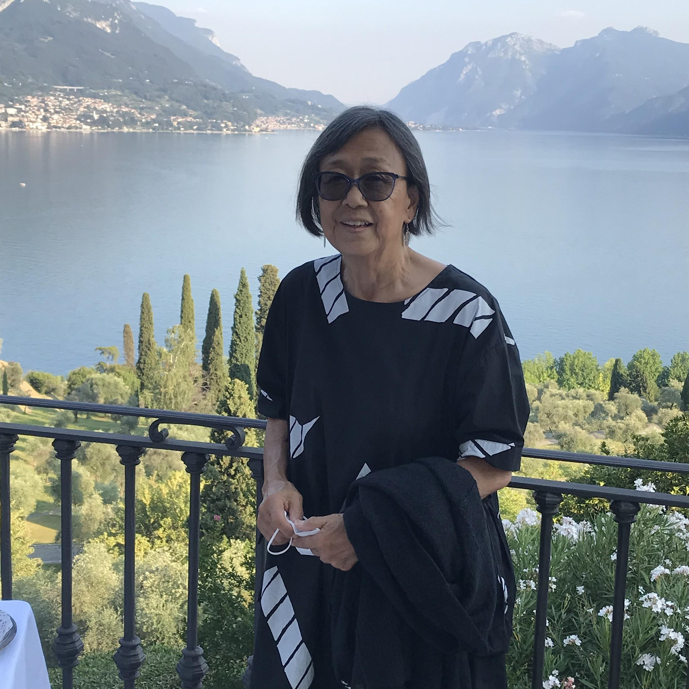
Observations/What Stood Out
Question - how to engage people with different views such as the “lineage folks.” - engage based on values/support lineage but reparations must include structural changes that impact all Black people and guarantee non-repetition
Although no one can provide first hand testimony about slavery, there are people who can share their experiences under the Jim Crow era
Narrative must reach Black people in places like the rural South
Important to build knowledge - in some African countries, people get their news from the radio and not social media
US/ Africa parallels - periods of oppression
US: slavery, Apartheid, Neo-Apartheid
Africa: Chattelization, Colonization and Neo-Colonization
STILL A LOT TO LEARN!! Thank you for your support and this
amazing opportunity to represent our work.

Slide 15
Vatican Action in July and Convening in Accra, Ghana in August
Vatican Meeting: the convening concluded with a delegation to the Vatican (I was not able to join) on July 18, 2022.
“Under the umbrella of the Global Circle for Reparations and Healing, a delegation of global reparations leaders was received today, July 18, 2022, in a formal meeting at the Vatican, by Bishop Paul Tighe, Secretary of the Pontifical Council of Culture, along with his assistant.
The purpose of the meeting was to begin a dialog with the Catholic Church on its role in sanctioning and benefiting from the Transatlantic slave trade and its legacy that inflicted immeasurable harm on Africa and its Global Diaspora.
Speaking on behalf of the Global Circle, Kamm Howard, Director of Reparations United, Dr Ron Daniels, convenor of National African American Reparations Commission (NAARC), Dr. Amara Enyia, strategist for the Global Circle for Reparations and Healing, and Nikole Hannah-Jones, author of the 1619 Project, delivered a Presentment outlining the harms and offenses of the Church, the legacy resulting from those harms and offenses and reparations measures that are needed for full repair and healing.
Accra Convening: The summit is being co-hosted by the AU (African Union) Commission, the Africa Transitional Justice Legacy Fund (ATJLF), the Africa-American Institute (AAI) and Global Black, with funding from the John D. and Catherine T. MacArthur Foundation.
It is part of a time-bound multi-year programme that will support the development of a unified and comprehensive strategy and advocacy agenda on reparatory justice and also present an opportunity to holistically discuss and reflect on strategies for reparations and racial healing as a result of the trans-Atlantic slave trade, slavery and colonialism.
Nana Akufo-Addo President of Ghana: “He, thus, asked participants at the summit not to overly concern themselves with modalities for the payment of reparations, but, rather, work to establish, unequivocally, first the justice in the call for reparations.”

Slide 16
1999 Accra Convening: Background
The first convening on African reparations in Accra took place in 1999. Organized by Dr Hamet Maulana and Mrs Debra Kofie, this conference calls for all international debt owed by Africa to the be 'unconditionally cancelled' and for the west to pay Africa $777 trillion for their role in enslaving Africans and colonizing the continent. Held on 12 August 1999, the Commission promises to set up an international team of lawyers from Africa and the Diaspora to pursue all legal means to collect the money, and issues a declaration entitled 'The Accra Declaration on Reparations and Repatriation'.
Resources:
http://news.bbc.co.uk/1/hi/world/africa/424984.stm
http://www.finalcall.com/international/1999/africa8-31-99.htm
http://estooks.wixsite.com/the-adid/black-power-and-reparations

